Slide 1

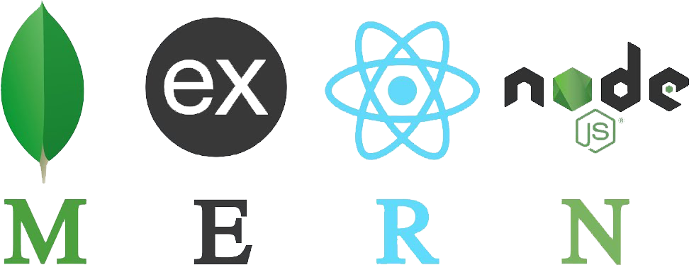
MERN Stack: A Full Stack Web App Dev from Front to Back
HANSEL G. DELOS SANTOS
MULTI-MEDIA SECTION
IT DEPARTMENT

Slide 2
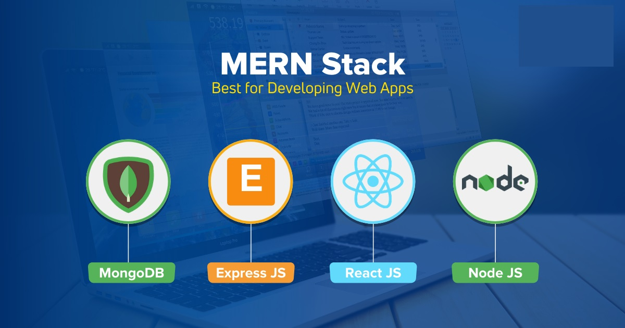

Slide 3
Session 1:
What is Full Stack Development?
Front end / Back end Technology
From end / Back end Framework
Database Technologies
MERN Stack Introduction
How does the MERN Stack work?
Intro to mongoDB
Intro to Node.js
Intro to Express JS
Intro to React JS
MERN Stack Project Environment Setup
Starting up MERN Dev using VSCode

Slide 4
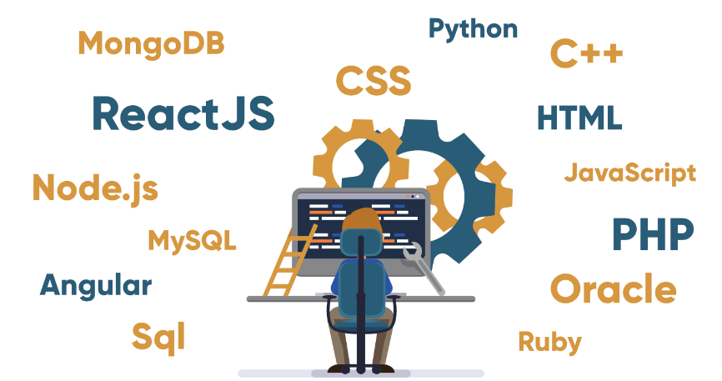
What is a Full Stack Development?
Full stack development: It refers to the development of both front end(client side) and back end(server side) portions of web application.
Full stack web Developers: Full stack web developers have the ability to design complete web applications and websites. They work on the frontend, backend, database and debugging of web applications or websites.

Slide 5

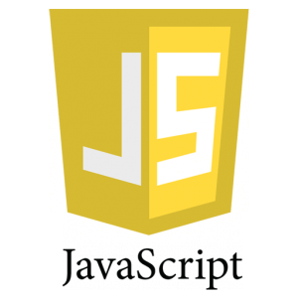
Front End Technology
Front end: It is the visible part of website or web application which is responsible for user experience. The user directly interacts with the front end portion of the web application or website.
Front end Languages: The front end portion is built by using some languages which are discussed below:
HTML: HTML stands for Hyper Text Markup Language
CSS: Cascading Style Sheets, fondly referred to as CSS, is a simply designed language intended to simplify the process of making web pages presentable.
JavaScript: JavaScript is a famous scripting language used to create the magic on the sites to make the site interactive for the user

Slide 6
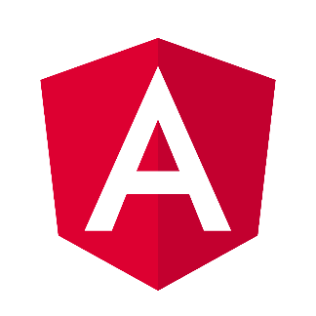
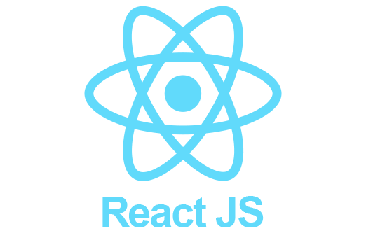
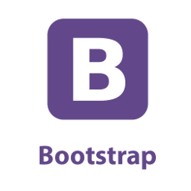
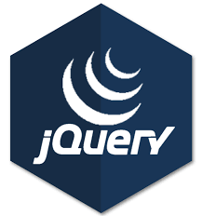
Front End frameworks and Libraries
AngularJS: AngularJs is a JavaScript open source front-end framework that is mainly used to develop single page web applications(SPAs
React.js: React is a declarative, efficient, and flexible JavaScript library for building user interfaces.
Bootstrap: Bootstrap is a free and open-source tool collection for creating responsive websites and web applications. It is the most popular HTML, CSS, and JavaScript framework for developing responsive, mobile-first web sites.
jQuery: jQuery is an open source JavaScript library that simplifies the interactions between an HTML/CSS document, or more precisely the Document Object Model (DOM), and JavaScript.
SASS (Syntactically Awesome Style Sheets) It is the most reliable, mature and robust CSS extension language.
Some other libraries and frameworks are: Semantic-UI, Foundation, Materialize, Backbone.js, Express.js, Ember.js etc.

Slide 7
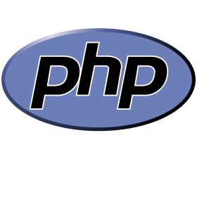
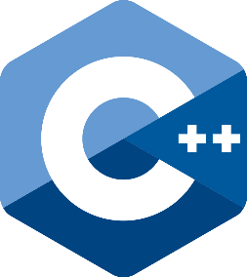
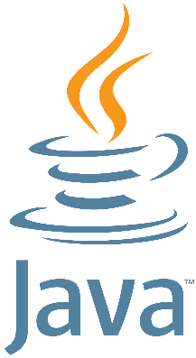

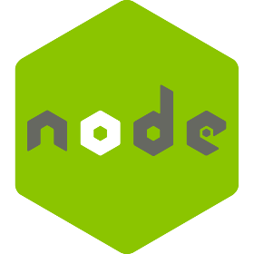
Back End Technology
It refers to the server-side development of web application or website with a primary focus on how the website works. It is responsible for managing the database through queries and APIs by client-side commands. This type of website mainly consists of three parts front end, back end, and database.
PHP: PHP is a server-side scripting language designed specifically for web development.
C++ It is a general purpose programming language and widely used now a days for competitive programming. It is also used as backend language.
Java: Java is one of the most popular and widely used programming language and platform.
Python: Python is a programming language that lets you work quickly and integrate systems more efficiently.
JavaScript: Javascript can be used as both (front end and back end) programming languages.
Node.js: Node.js is an open source and cross-platform runtime environment for executing JavaScript code outside of a browser.
Back End Frameworks: The list of back end frameworks are: Express, Django, Rails, Laravel, Spring etc.
The other back end program/scripting languages are: C#, Ruby, REST, GO etc.

Slide 8
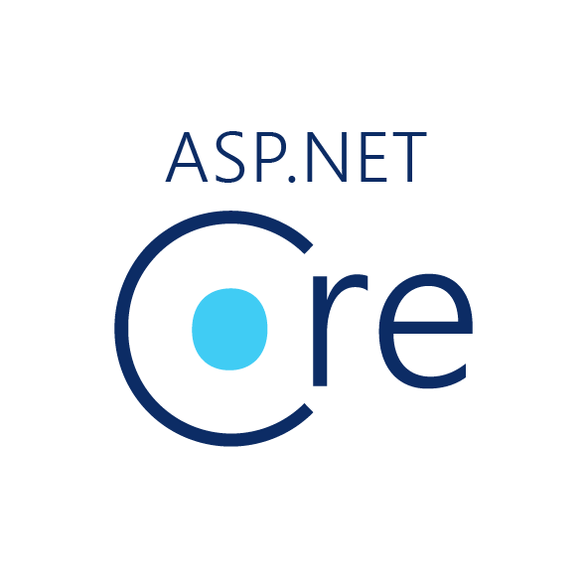

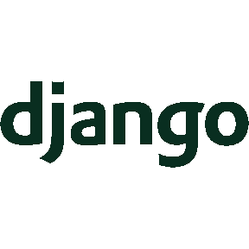
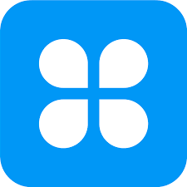
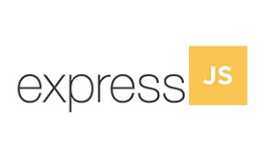


Back End Framework
Popular Frameworks
Django
AppMaster
Express.js
Flask
Laravel
Ruby on Rails
Spring
ASP.NET Core

Slide 9
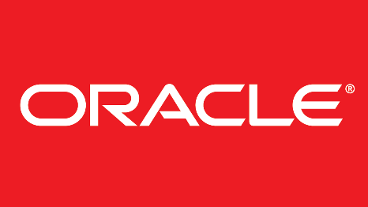
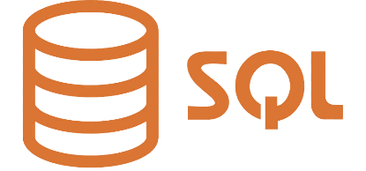

Database Technology
Database is the collection of inter-related data which helps in efficient retrieval, insertion and deletion of data from database and organizes the data in the form of tables, views, schemas, reports etc.
Oracle: Oracle database is the collection of data which is treated as a unit.
MongoDB: MongoDB, the most popular NoSQL database, is an open source document-oriented database. The term ‘NoSQL’ means ‘non-relational
Sql: Structured Query Language is a standard Database language which is used to create, maintain and retrieve the relational database.

Slide 10
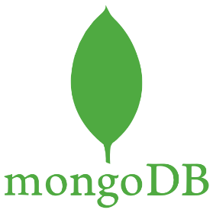

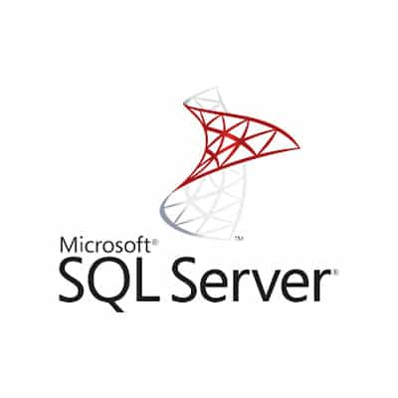
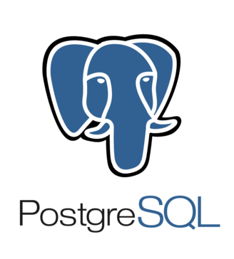
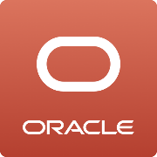
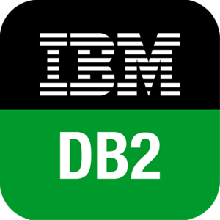
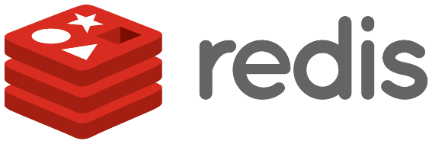
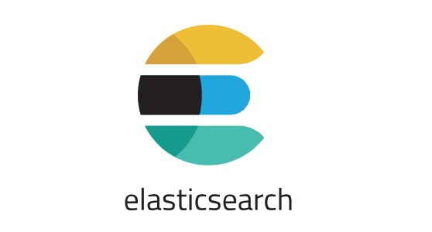
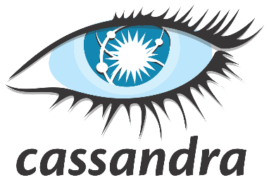
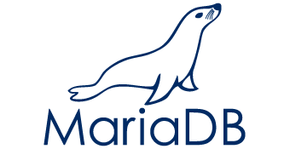
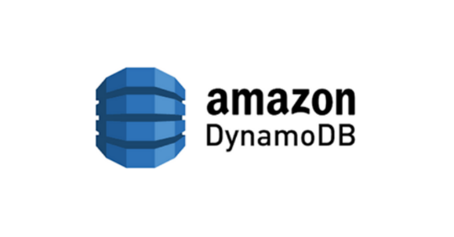
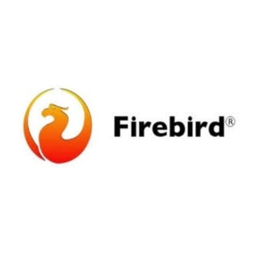
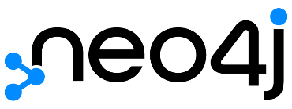
Which is best Database for web applications In 2022?
Oracle
MySQL
MS SQL Server
PostgreSQL
MongoDB (noSQL)
IBM DB2
Redis
Elasticsearch
Cassandra
MariaDB
OrientDB (noSQL)
SQLite
DynamoDB (noSQL)
Neo4j (noSQL)
Firebirdsql

Slide 11
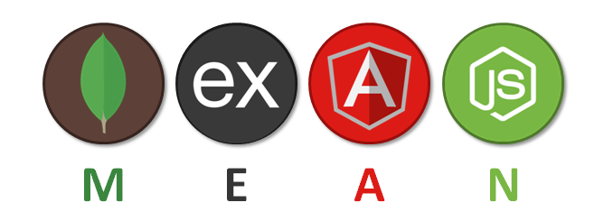
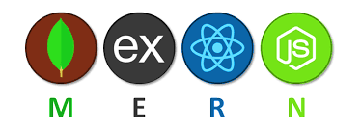
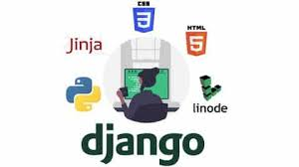
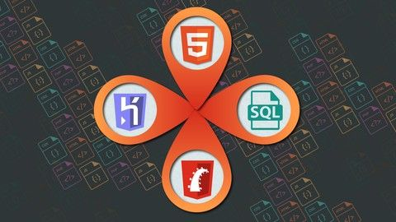
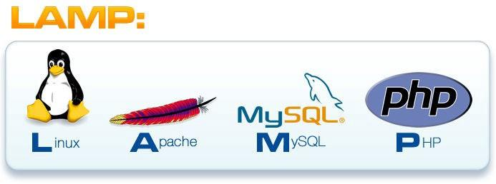
Popular Stacks
MEAN Stack: MongoDB, Express, AngularJS and Node.js.
MERN Stack: MongoDB, Express, ReactJS and Node.js
Django Stack: Django, python and MySQL as Database.
Rails or Ruby on Rails: Uses Ruby, PHP and MySQL.
LAMP Stack: Linux, Apache, MySQL and PHP.

Slide 12
Introduction to MERN Stack
MERN stack is a collection of technologies that enables faster application development. It is used by developers worldwide.
The main purpose of using MERN stack is to develop apps using JavaScript only. This is because the four technologies that make up the technology stack are all JS-based.
Thus, if one knows JavaScript (and JSON), the backend, frontend, and database can be operated easily.

Slide 13
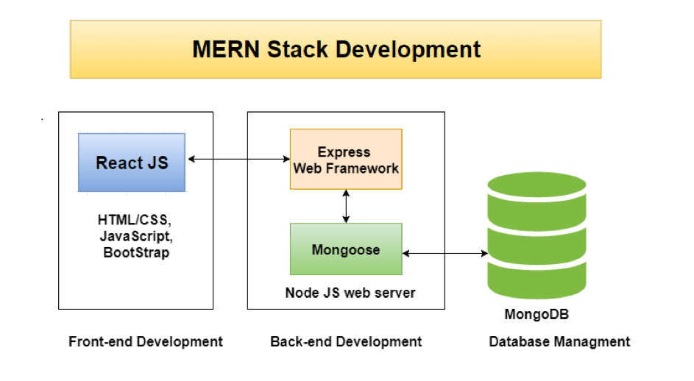
How does MERN Stack works?

Slide 14

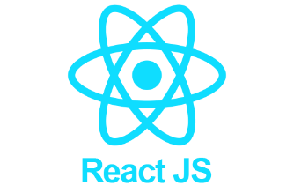
MERN Stack Full Form
MERN Stack is a compilation of four different technologies that work together to develop dynamic web apps and websites.
It is a contraction for four different technologies as mentioned below:
M - MongoDB
E - ExpressJS
R - ReactJS
N - NodeJS

Slide 15
Why Should You Work With MERN Stack?
There are many good reasons to use the MERN Stack. For example, it allows the creation of a 3-tier architecture that includes frontend, backend, and database using JavaScript and JSON.
MongoDB, which is the base of the MERN stack, is designed to store JSON data natively. Everything in it, including CLI and query language, is built using JSON and JS.
It comes in a variant called MongoDB Atlas that further eases database management by offering an auto-scaling MongoDB cluster on any cloud provider and with just a few clicks.
Express is a server-side framework that wraps HTTP requests and responses and makes mapping URLs to server-side functions easy. This perfectly complements the ReactJS framework, a front-end JS framework for developing interactive UIs in HTML while communicating with the server.
As the two technologies work with JSON, data flows seamlessly, making it possible to develop fast and debug easily. To make sense of the entire system, you need to understand only one language, i.e., JavaScript and the JSON document structure.

Slide 16
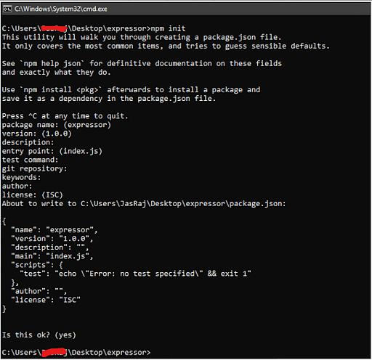
MERN Dependencies
Considering you’ve downloaded and configured all the four aforementioned technologies,
you need to know how to create a new project folder to get started with the MERN stack.
Next, you need to open the folder on the CMD (or terminal) and enter the following command to initialize a package.json file:
npm init
npm install <> - node package
management

Slide 17
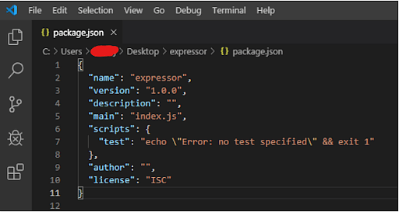
MERN standard JSON package

Slide 18
MERN Stack Components
There are four components of the MERN stack.
The first component is MongoDB, which is a NoSql database management system.
The second MERN stack component is ExpressJS. It is a backend web application framework for NodeJS.
The third component is ReactJS, a JavaScript library for developing UIs based on UI components.
The final component of the MERN stack is NodeJS. It is a JS runtime environment, i.e., it enables running JavaScript code outside the browser.

Slide 19

MERN Stack component: MongoDB
MongoDB is a NoSQL DBMS where data is stored in the form of documents having key-value pairs similar to JSON objects.
MongoDB enables users to create databases / schemas.
It offers the Mongo shell that provides a JS interface for deleting, querying, and updating the records.

Slide 20
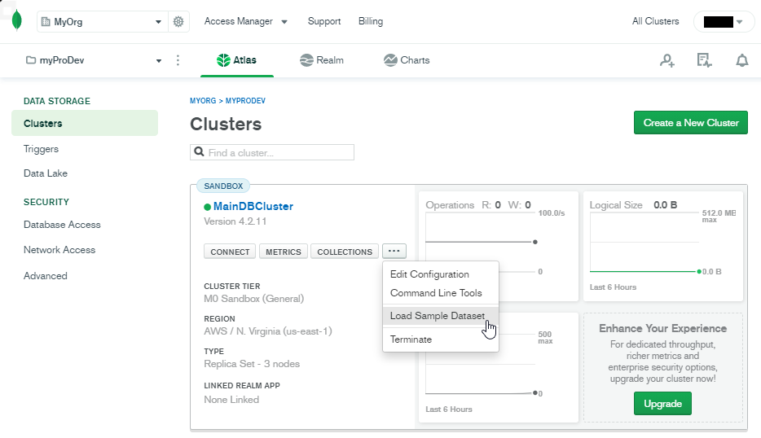
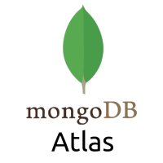
MongoDB Atlas
The core of our developer data platform is a multi-cloud database service built for resilience, scale, and the highest levels of data privacy and security.
With MongoDB Atlas, your database is a trusted foundation that enables you to work with data the way you want – easily and effortlessly.

Slide 21
MERN Stack component: ExpressJS
ExpressJS is a NodeJS framework that simplifies writing the backend code.
It saves you from creating multiple Node modules.
For keeping the code precise, ExpressJS offers a range of middleware.

Slide 22
MERN Stack component: ReactJS
ReactJS is a JS library that allows the development of user interfaces for mobile apps and SPAs (Single Page Applications).
It allows you to code JavaScript and develop UI components.
The JS library uses virtual DOM for doing everything.

Slide 23
Largest Companies That Use React: At a Glance
Company | Revenue | Number of employees
Meta | $85.96 billion (2020) | 68,177 (2021)
Netflix | $29.69 billion (2021) | 12,135 (2021)
Uber | $11.1 billion (2020) | 24,700 (2021)
Yahoo! | $5.16 billion (2021) | 8,500 (2021)
Airbnb | $3.38 billion (2020) | 5,597 (2020)
Atlassian | $2.08 billion (2021) | 6,433 (2021)
Dropbox | $1.91 billion (2020) | 2,548 (2021)
The New York Times | $1.78 billion (2020) | 4,700 (2020)
Zendesk | $1.03 billion (2020) | 4,000+ (2021)
Asana | $227 million (2021) | 1080 (2021)

Slide 24
MERN Stack component: NodeJS
NodeJS is an open-source JavaScript runtime environment that allows users to run code on the server.
It comes with the node package manager or npm, enabling users to select from a wide selection of node modules or packages.
Being developed on the Chrome JavaScript Engine enables Node to execute code faster.

Slide 25


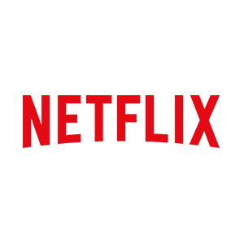
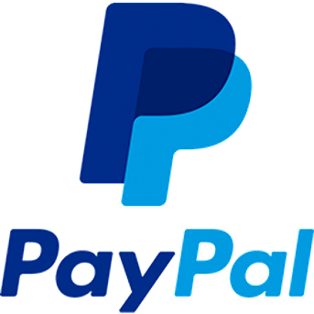
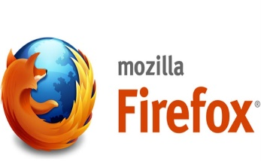


Popular Companies That Uses nodejs/expressjs: At a Glance
Company
Netflix
Trello
Paypal
Linkedln
Walmart
Uber
Nasa
Mozilla Firefox
Yahoo
GoDaddy

Slide 26
MERN Stack Project Environment Setup and Back-End Development
Download and install nodeJS - https://nodejs.org/en/
Open CLI (cmd) to check the node version: c:\> node
Download and install VSCode - https://code.visualstudio.com/
Open VSCode and create a folder MERN-Project
Create a subfolder backend
Create a new empty file server.js then save
Open the terminal in VSCode and go to server folder: cd backend
Run npm (node package management) in the terminal: npm init –y (extract json dependencies)
Run npm install express in the terminal
Write the code in server.js then save all

Slide 27
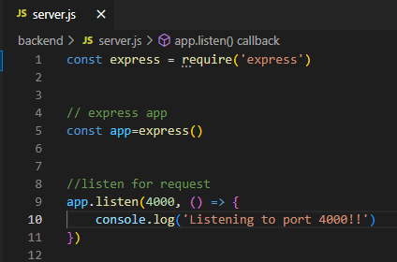
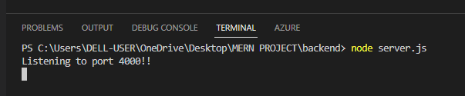
Write the code in server.js
Run terminal in VSCode: node server.js
Control + C to terminate the running web server

Slide 28
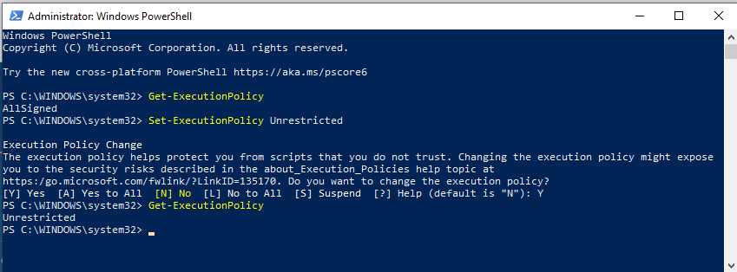
Install nodemon – node utility
Download and install nodemon from the VSCode Terminal –
npm install –g nodemon
If installation persist (windows). Workaround Open PowerShell as administrator
If installation persist in (Mac). Workaround: sudo npm install –g nodemon

Slide 29
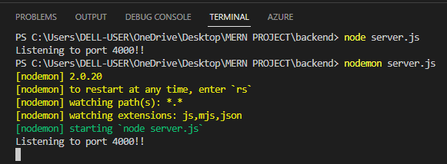
Running nodemon
From the VSCode Terminal run: nodemon server.js
Try to change the console.log(‘Server is running in PORT 4000’) then save all
Notice the server log from the terminal: real-time updates

Slide 30
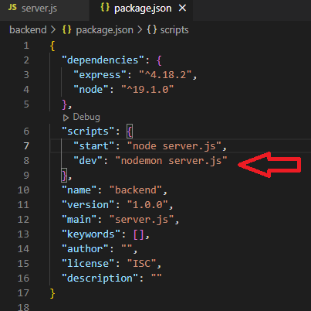
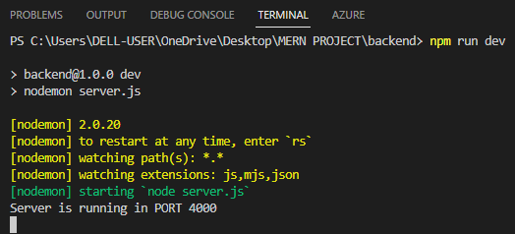
Debug the package.json file
Add the parameter
,“dev”: “nodemon server.js” from the scripts then save all
Then run from the vscode terminal:
npm run dev

Slide 31



Congratulation! You’ve developed a MERN in back-end. To be continued… 2nd session

Slide 32




VSCode Extensions
Download Extensions from VSCode: (optional)
Auto Rename Tag
Bracket Pair Colorizer
ES7 React/Redux/GraphQL/React Native
Snippets
Javascript code snippets
Material Icon Theme
Prettier Code Formatter

Slide 33
Thank You…
Q & A
See You in Session 2 (Nov. 29, 2022)
Outline
Developing a REST API using npm
Installing Express & nodemon packages using npm
Modifying the package JSON
Creating an app.js in Express with ROUTES
Running the app.js from the terminal
Explaining further in ROUTES
Adding middleware in Express
Connect to database using mongoDB / Cloud (mongoDB Atlas)
Implementing CRUD Operations

Slide 34
References:
https://www.w3schools.com/whatis/whatis_fullstack.asp
https://www.mongodb.com/
https://reactjs.org/tutorial/tutorial.html
https://nodejs.org/en/
https://expressjs.com/
https://code.visualstudio.com/

